Slide 1
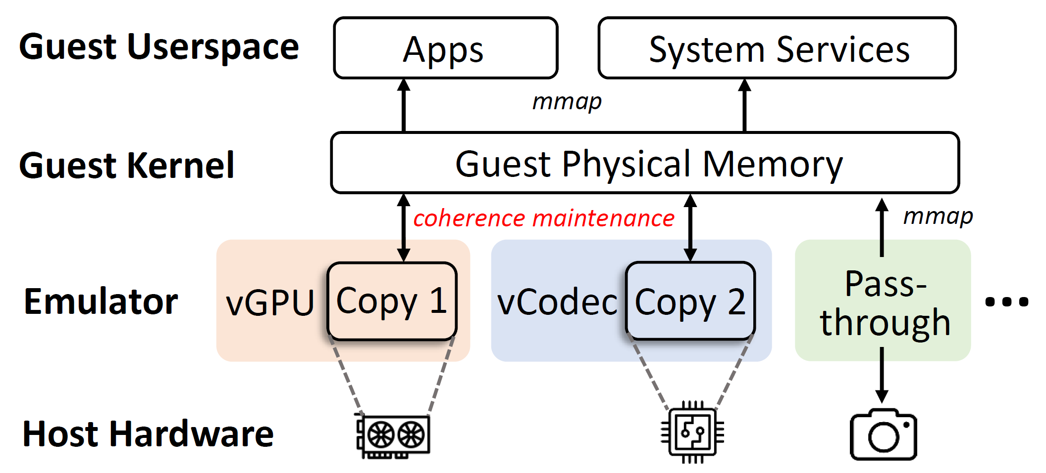
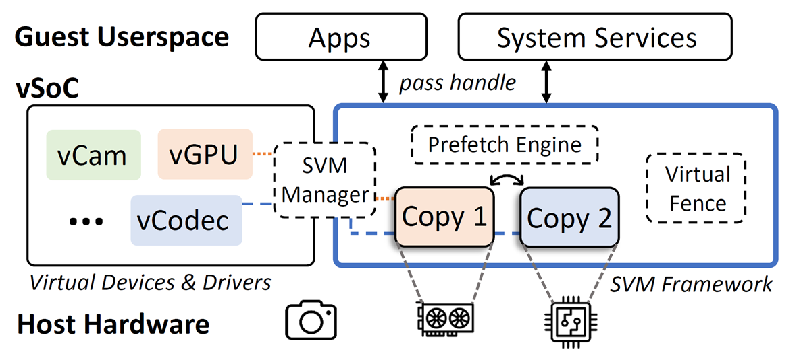
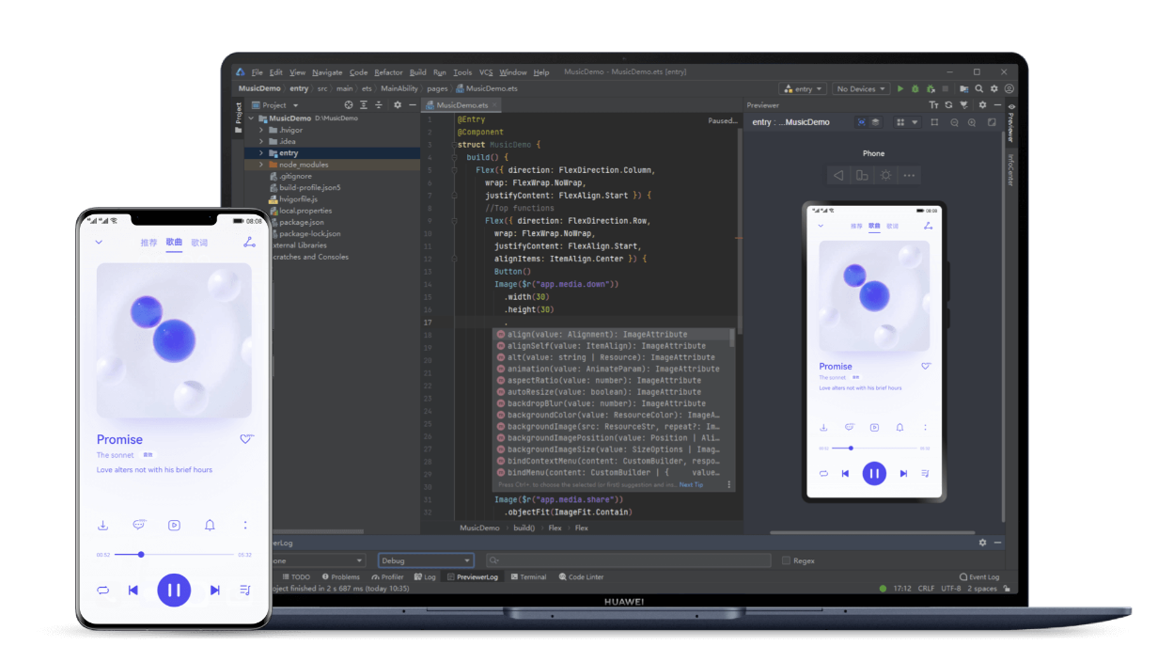
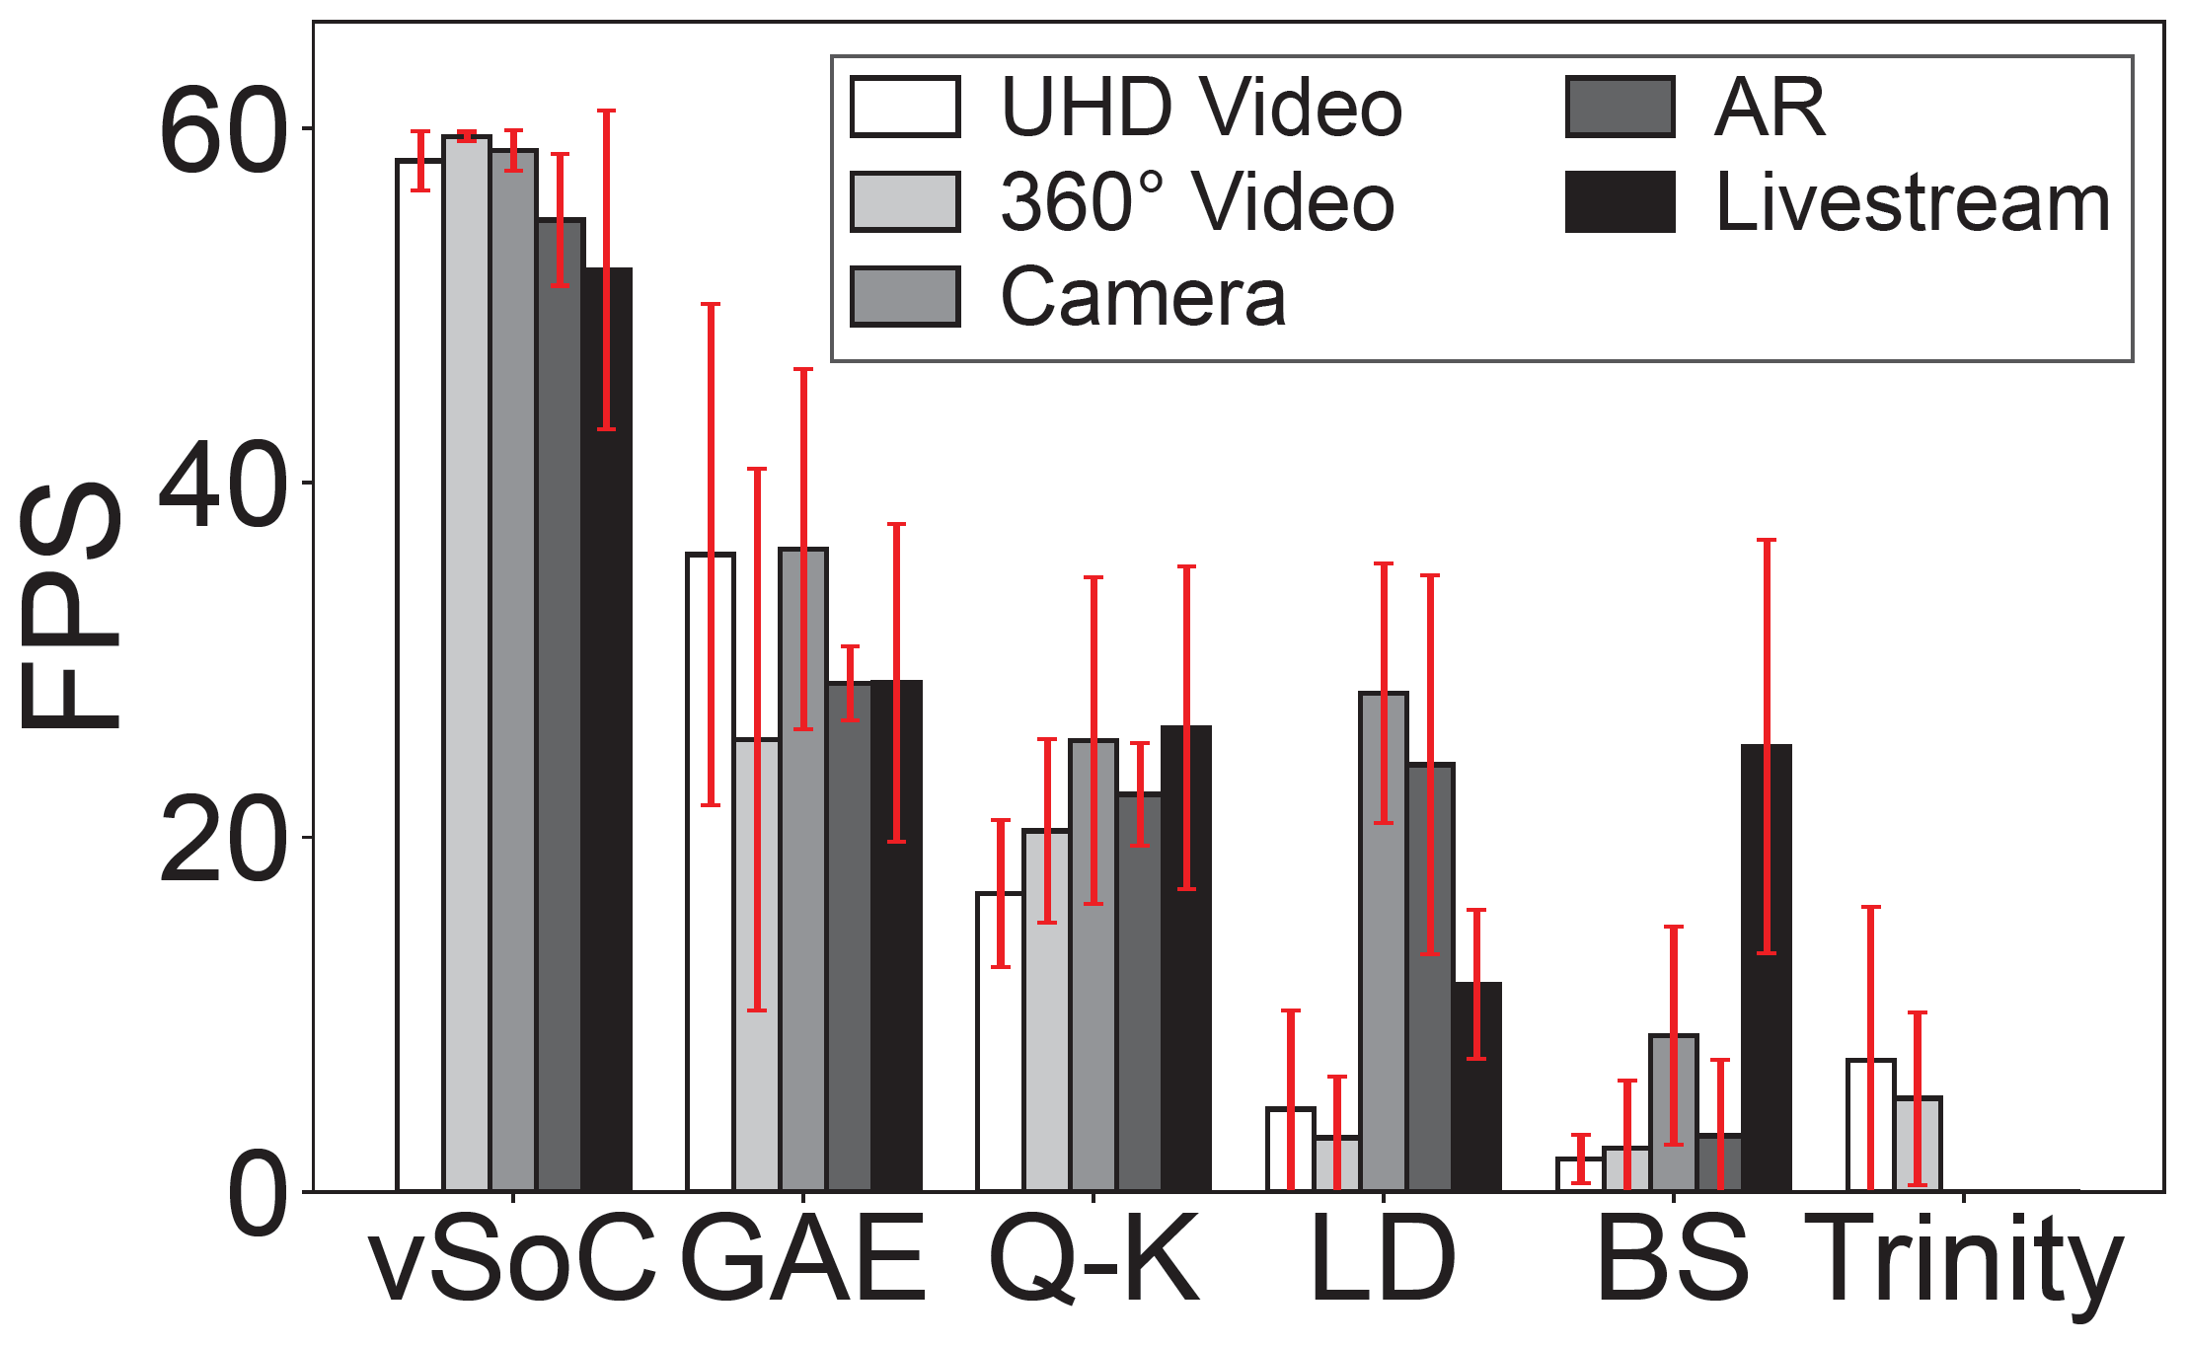
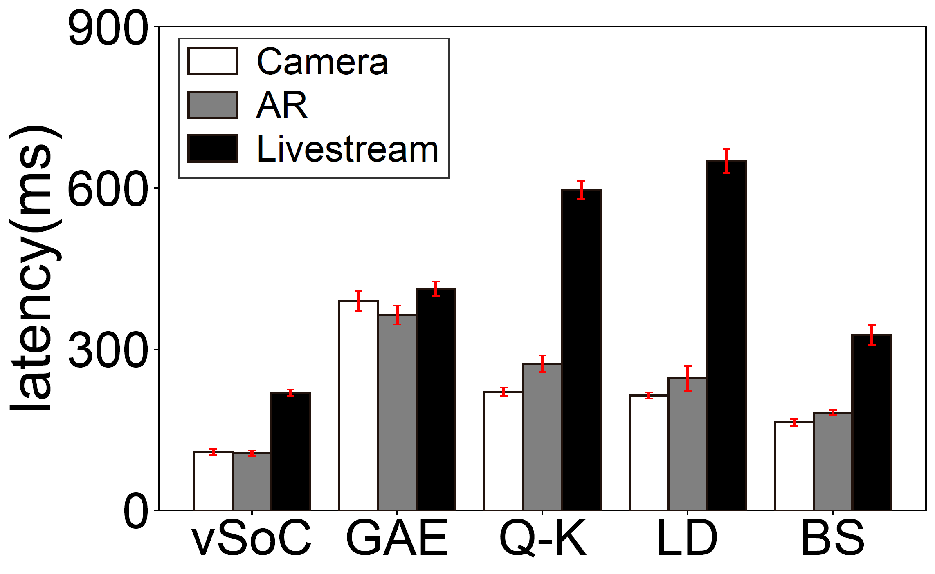
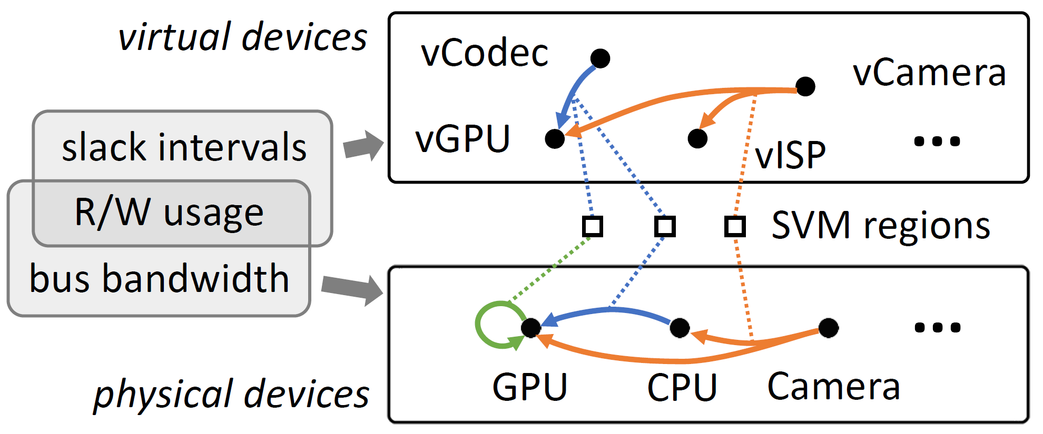
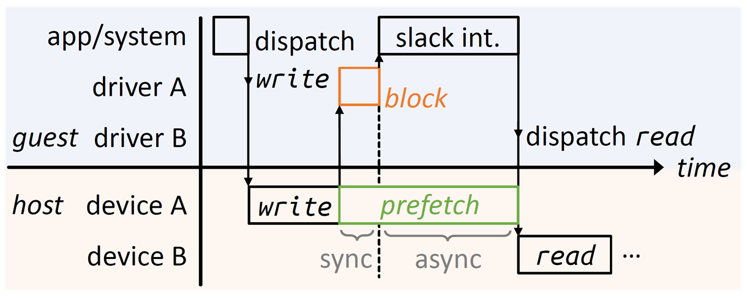
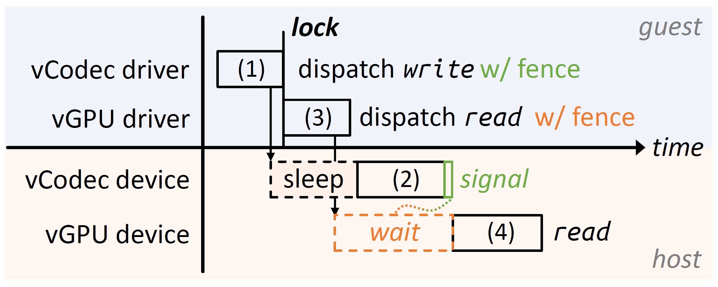
vSoC: Efficient Virtual System-on-Chip on Heterogeneous Hardware
Jiaxing Qiu, Zijie Zhou, Yang Li, Zhenhua Li, Feng Qian, Hao Lin, Di Gao, Haitao Su, Xin Miao, Yunhao Liu, Tianyin Xu
Key to an efficient virtual SoC: virtual SoC ≠ sum(virtual devices)!
Motivation
System Overview
Unified virtual device architecture with SVM Framework
Exploiting the slack intervals of mobile shared memory for ahead-of-time coherence management
1.8-9.0× performance on emerging mobile apps
Adopted by
HUAWEI DevEco Studio
Source available at
modular architecture
Mainstream emulators struggle to run emerging apps
Use cases
Mobile App development
Mobile Cloud Compute
System Design
SVM Manager: globally manages SVM regions and provides direct data paths between virtual devices
Prefetch Engine: provides a robust memory coherence protocol based on semi-asynchronous prefetch
Virtual Fence: efficient command access ordering across virtual devices by pushing guest order semantics down to the host

